Slide 1
Large-scale Taxonomy Induction Using Entity and Word Embeddings
Ristoski, Petar, et al. "Large-scale taxonomy induction using entity and word embeddings." Proceedings of the International Conference on Web Intelligence. ACM, 2017.

Slide 2
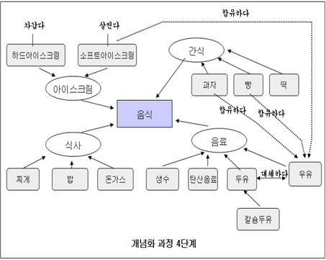
Introduction
Ontology?
A knowledge representation framework consisting of classes, relational properties, and instances
Hierarchical concepts and properties

Slide 3
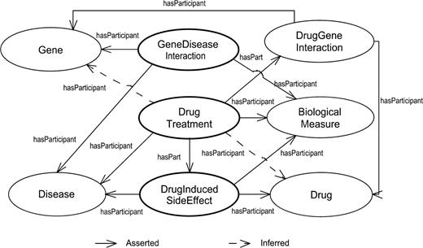
Introduction
Ontology?
A knowledge representation framework consisting of classes, relational properties, and instances
Knowledge graph (instance)

Slide 4
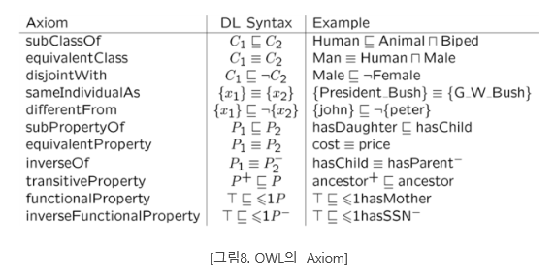
Introduction
A basic building block of an ontology is a class, where the classes are organized with “is-a” relations (or class subsumption axioms).

Slide 5
Introduction
A basic building block of an ontology is a class, where the classes are organized with “is-a” relations (or class subsumption axioms).
Manually curating a class hierarchy for a given knowledge graph is time consuming and requires a high cost.
Proposing the TIEmb approach for automatic unsupervised class subsumption axiom extraction from knowledge bases using entity and text embeddings (RDF2vec).
RDF : a basic standard format (model) for ontological expression

Slide 6
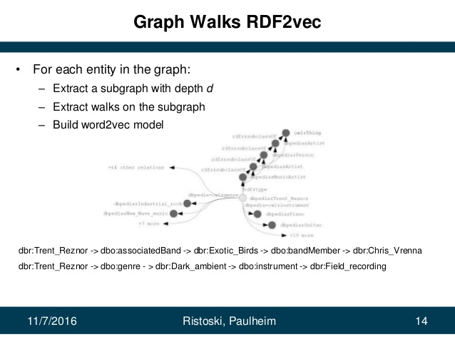
Introduction
RDF2vec

Slide 7
Introduction
The underlying assumptions
the majority of all instances of the same class are positioned close to each other in the embedded space.
each class in the knowledge base can be represented as a cluster of the instances in the embedded space, defined with a centroid and an average radius.
clusters that completely or partially subsume each other, indicate class subsumption axiom.

Slide 8
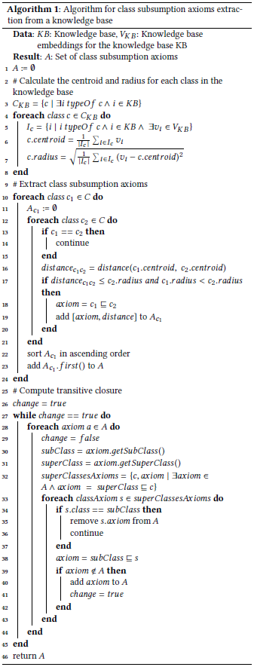
Approach
Assumption
entities which belong to the same class are positioned close to each other in the vector space
instances of a more specific class should be positioned closer to each other on average than instances of a broader class.
농구
축구
player
player
player
player
선수1
선수2
선수3
선수4
team
team
team
team
소속팀1
소속팀2

Slide 9
Approach
Two inputs
a knowledge base as its input, which contains a set of instances, where each instance has one or more class types
the knowledge base embeddings, where each instance is represented as n-dimensional feature vector
Output
- a set of class subsumption axioms

Slide 10
Approach
radius
class
centroid
instance
RDF2vec space

Slide 11
Approach
Class subsumption axiom (condition)
(distance_{c1c2} < c2:radius) && (c1:radius < c2:radius)
*distance_{c1c2} = distance (c1:centroid; c2:centroid)
select the axiom with the smallest distance
subclassOf
RDF2vec space

Slide 12
Approach
스포츠
subclassOf
Transitive closure
구기종목
subclassOf
소속팀1

Slide 13
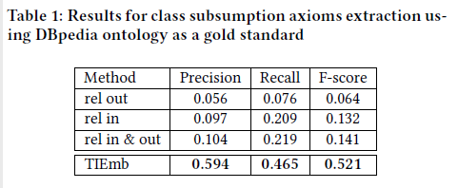
Experiment 1
Dataset : 2016-04 DBpedia dataset and the corresponding ontology (classes that have at least one instance, resulting in 415 classes, 632 atomic class subsumption axioms)
RDF2vec: 250 random walks, Skip-Gram (window 5, d 200)
baseline : incoming, outgoing, in/out relation feature generation approaches

Slide 14
Experiment 1
Error analysis (false positive)
extracts subsumption axioms for classes on the same level in the hierarchy, or siblings classes
e.g. dbo:Bird ⊆ dbo:Mammal.
Reason : the centroids of the classes are positioned very close to each other in the embeddings space
Some would not necessarily be incorrect, but those axioms simply do not exist in the DBpedia ontology
e.g. dbo:Senator ⊆ dbo:OfficeHolder

Slide 15
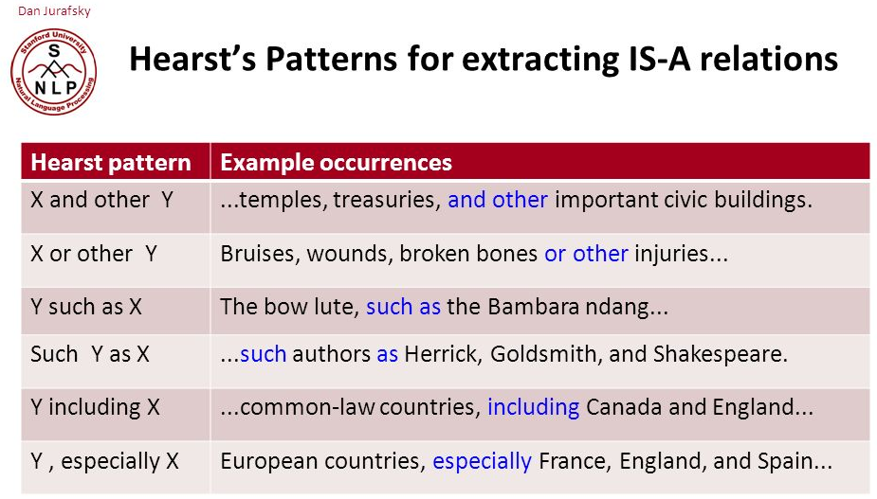
Experiment 2
Dataset : WebIsA database
generated from the Common-Crawl by Hearst patterns
High coverage, low precision
Domain class: Person, Place
Use DBpedia as filters
select all the subclasses of dbo:Person (184 in total) and dbo:Place (176 in total) in Dbpedia
select all the instances of these classes in WebIsADb
expand the set of classes by addingall siblings of the corresponding class
Ex. ‘SoccerPlayer’ (c) -> “Cristiano Ronaldo” (i) ->’Star’, ‘Footballer’ … (c)
Use Dbpedia RDF2vec embeddings

Slide 16
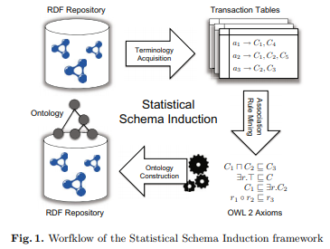
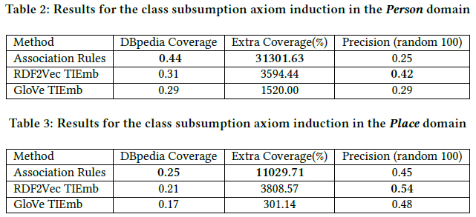
Experiment 2
Baseline : association rules (Apriori algorithm)
Support, confidence > 50
Measurement : Dbpedia coverage, Extra Coverage, Precision (random 100)

Slide 17
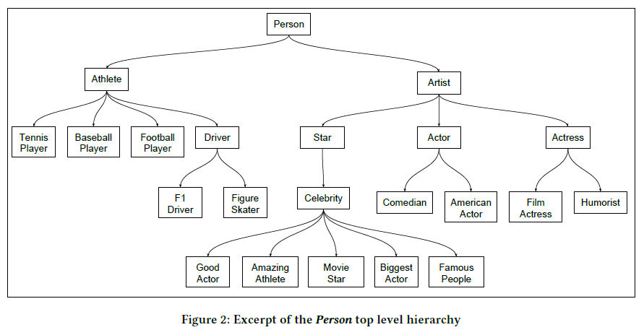
Experiment 2

Slide 18
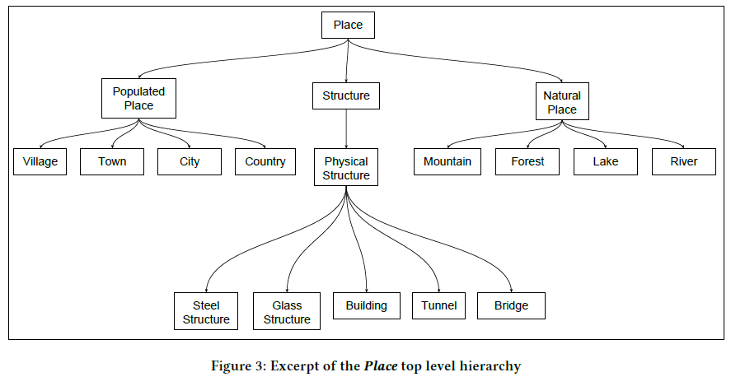
Experiment 2

Slide 19
Conclusion
the approach cannot only be used for taxonomy induction, but also for the problem of type prediction
interesting to see howembeddings coming from text and graphs can be combined reasonably.
want to investigate how higher-level semantic knowledge, such as class restrictions or complementarity, can be mined using an embedding-based approach

